Slide 1
Python assignment for GE
Drone programming

Slide 2
Installing cigwin
By clicking on https://ardupilot.org/dev/docs/building-setup-windows-cygwin.html#building-setup-windows-cygwin
Then instal following packages autoconf
Devel | autoconf: Wrapper scripts for autoconf commands
automake
Devel | automake: Wrapper scripts for automake and aclocal
ccache
Devel | ccache: A C compiler cache for improving recompilation
cygwin32-gcc-g++
Devel | GCC for Cygwin 32bit toolchain (C++)
gcc-g++
Devel | gcc-g++ GNU Compiler Collection (C++)
git
Devel | git: Distributed version control system
And 9 more packages also

Slide 3
Mave proxy
Installing mave proxy by clicking http://firmware.ardupilot.org/Tools/MAVProxy/.
Then download its latest version MAVProxySetup-1.8.6.exe
Then i have install pip version pip install empy pyserial pymavlink
After that i am getting error like this on next page

Slide 4
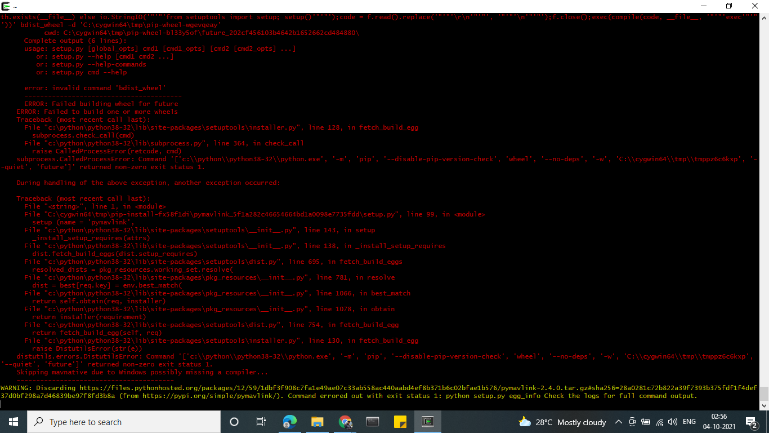
Error while installing pip command

Slide 5
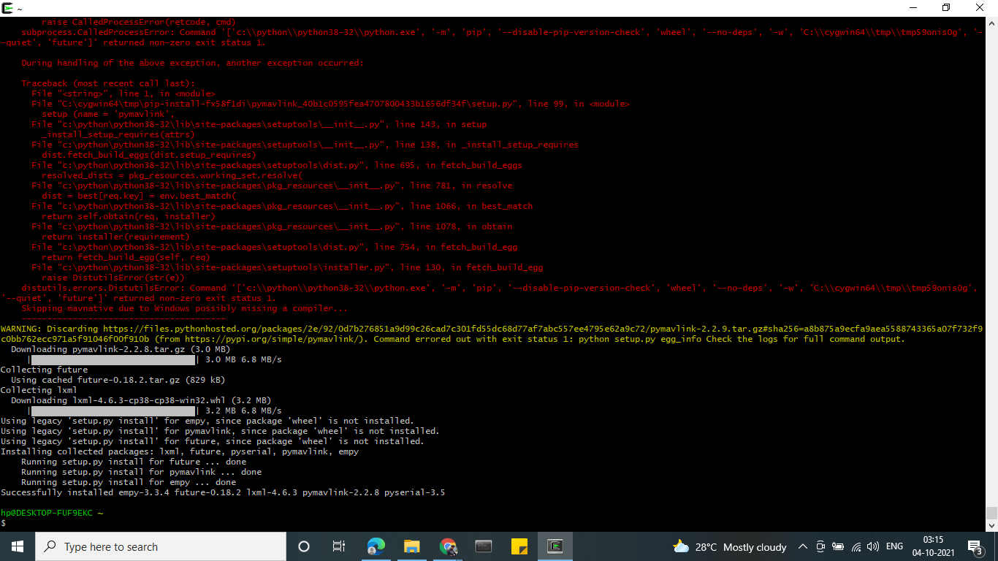
Error resolved by upgrading python3 pip install --upgrade pip
After adding pip install empy pyserial pymavlink

Slide 6
Ardu pilot
I been using git clone https://github.com/ardupilot/ardupilot.git
And i want the 346 version because after research i know that its an stable version as compare to latest version $ git clone -b Copter-3.4.6 https://github.com/ardupilot/ardupilot.git
By installing i go with cd ardupilot
Next successfully installed image

Slide 7
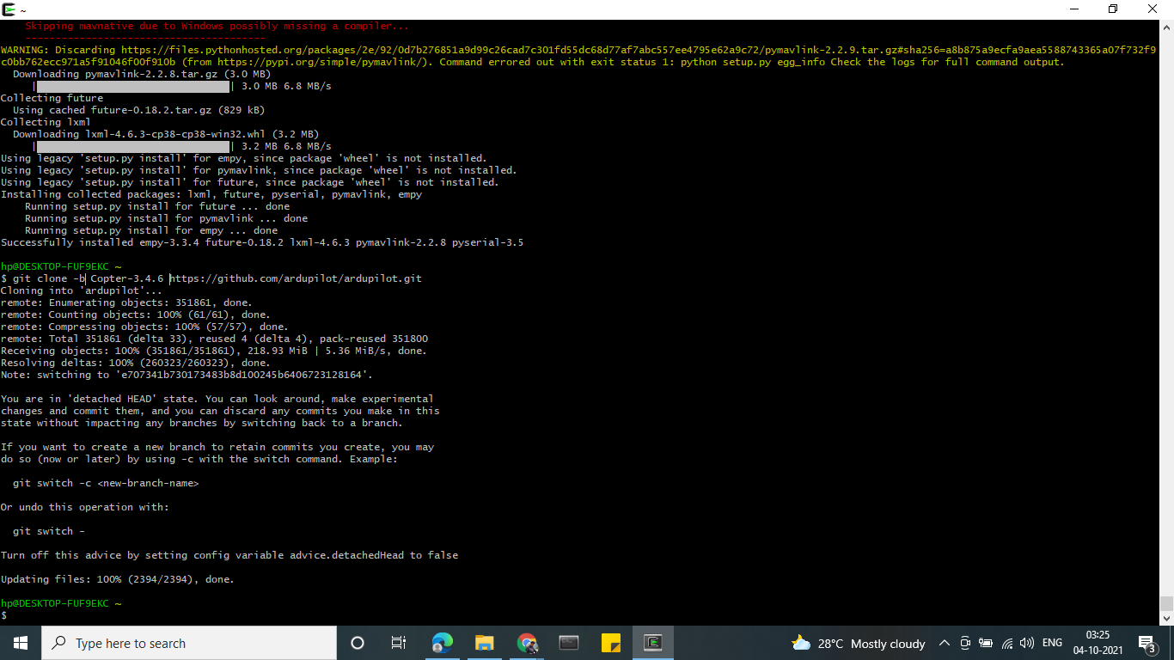
Image

Slide 8
C:\WINDOWS\system32>python
Python 3.8.5 (tags/v3.8.5:580fbb0, Jul 20 2020, 15:43:08) [MSC v.1926 32 bit (Intel)] on win32
Type "help", "copyright", "credits" or "license" for more information.
>>> exit()
Using this python version

Slide 9
sitl
After that successfully installing ardupilot cloning
I am running sitl by using ../Tools/autotest/sim_vehicle.py --map --console
Then i got stuck in opening sitl so i tried https://discuss.ardupilot.org/t/waf-crashes-on-copter-3-6-5/48682

Slide 10
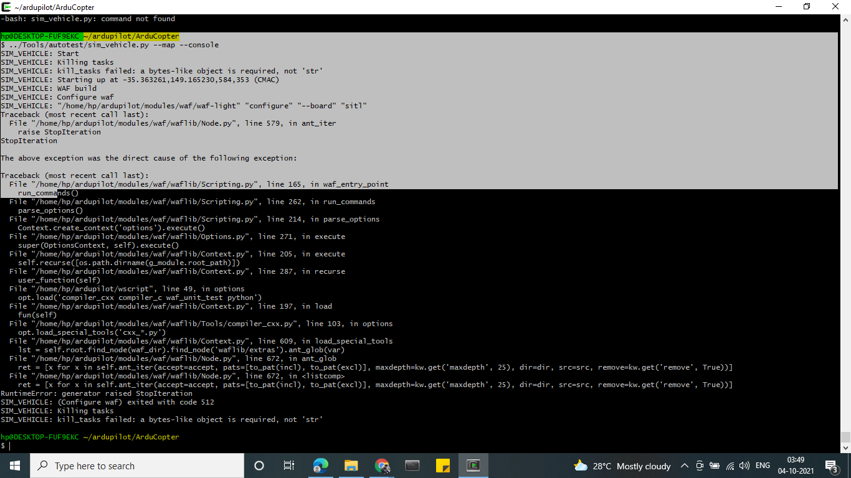

Slide 11
Elaborating issue regarding sitl
I am getting again an error while loading this
Also take reference from https://discuss.ardupilot.org/t/copter-sitl-binary-crashing-unexplicably/71737
And stack overflow https://stackoverflow.com/questions/51700960/runtimeerror-generator-raised-stopiteration-every-time-i-try-to-run-app
Trying clone the waf file https://ardupilot.org/dev/docs/git-clone.html#git-clone
Not successful its throwing error again and again

Slide 12
Python script for mission attached below in the mail
As i got an attempt but due to my system fail i didn't get an hands on simulation

